Slide 1
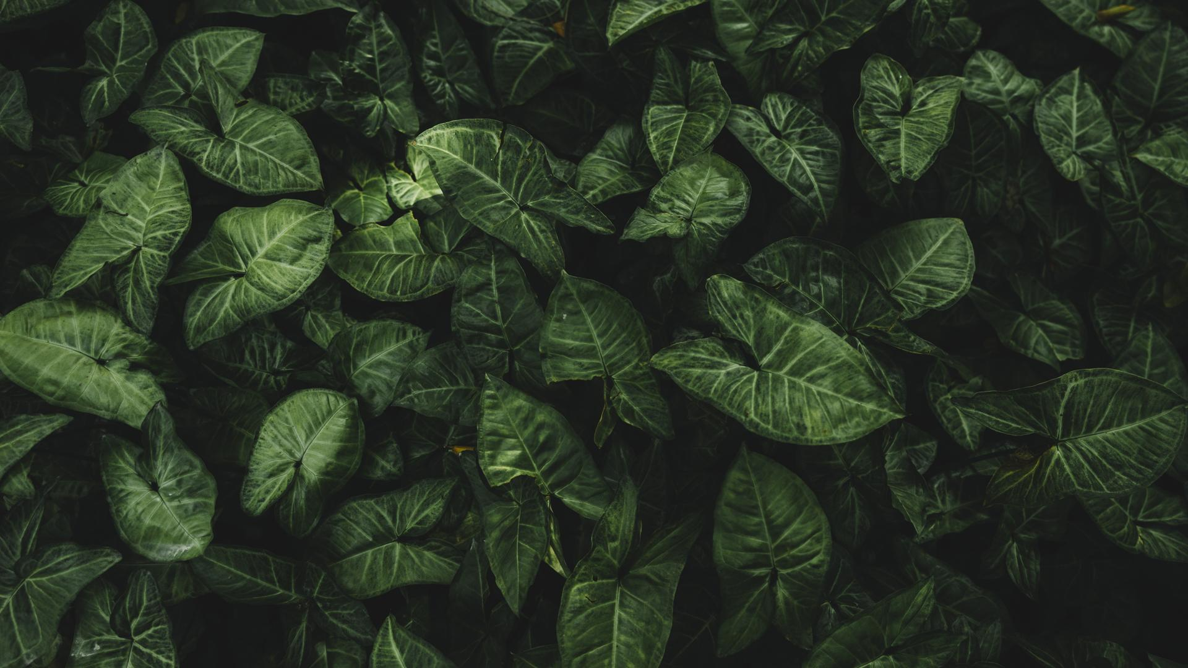

Planthora
Identifies and Provides Treatment For Plant’s Diseases
Our Guide
Mr. Manikandan M

Slide 2
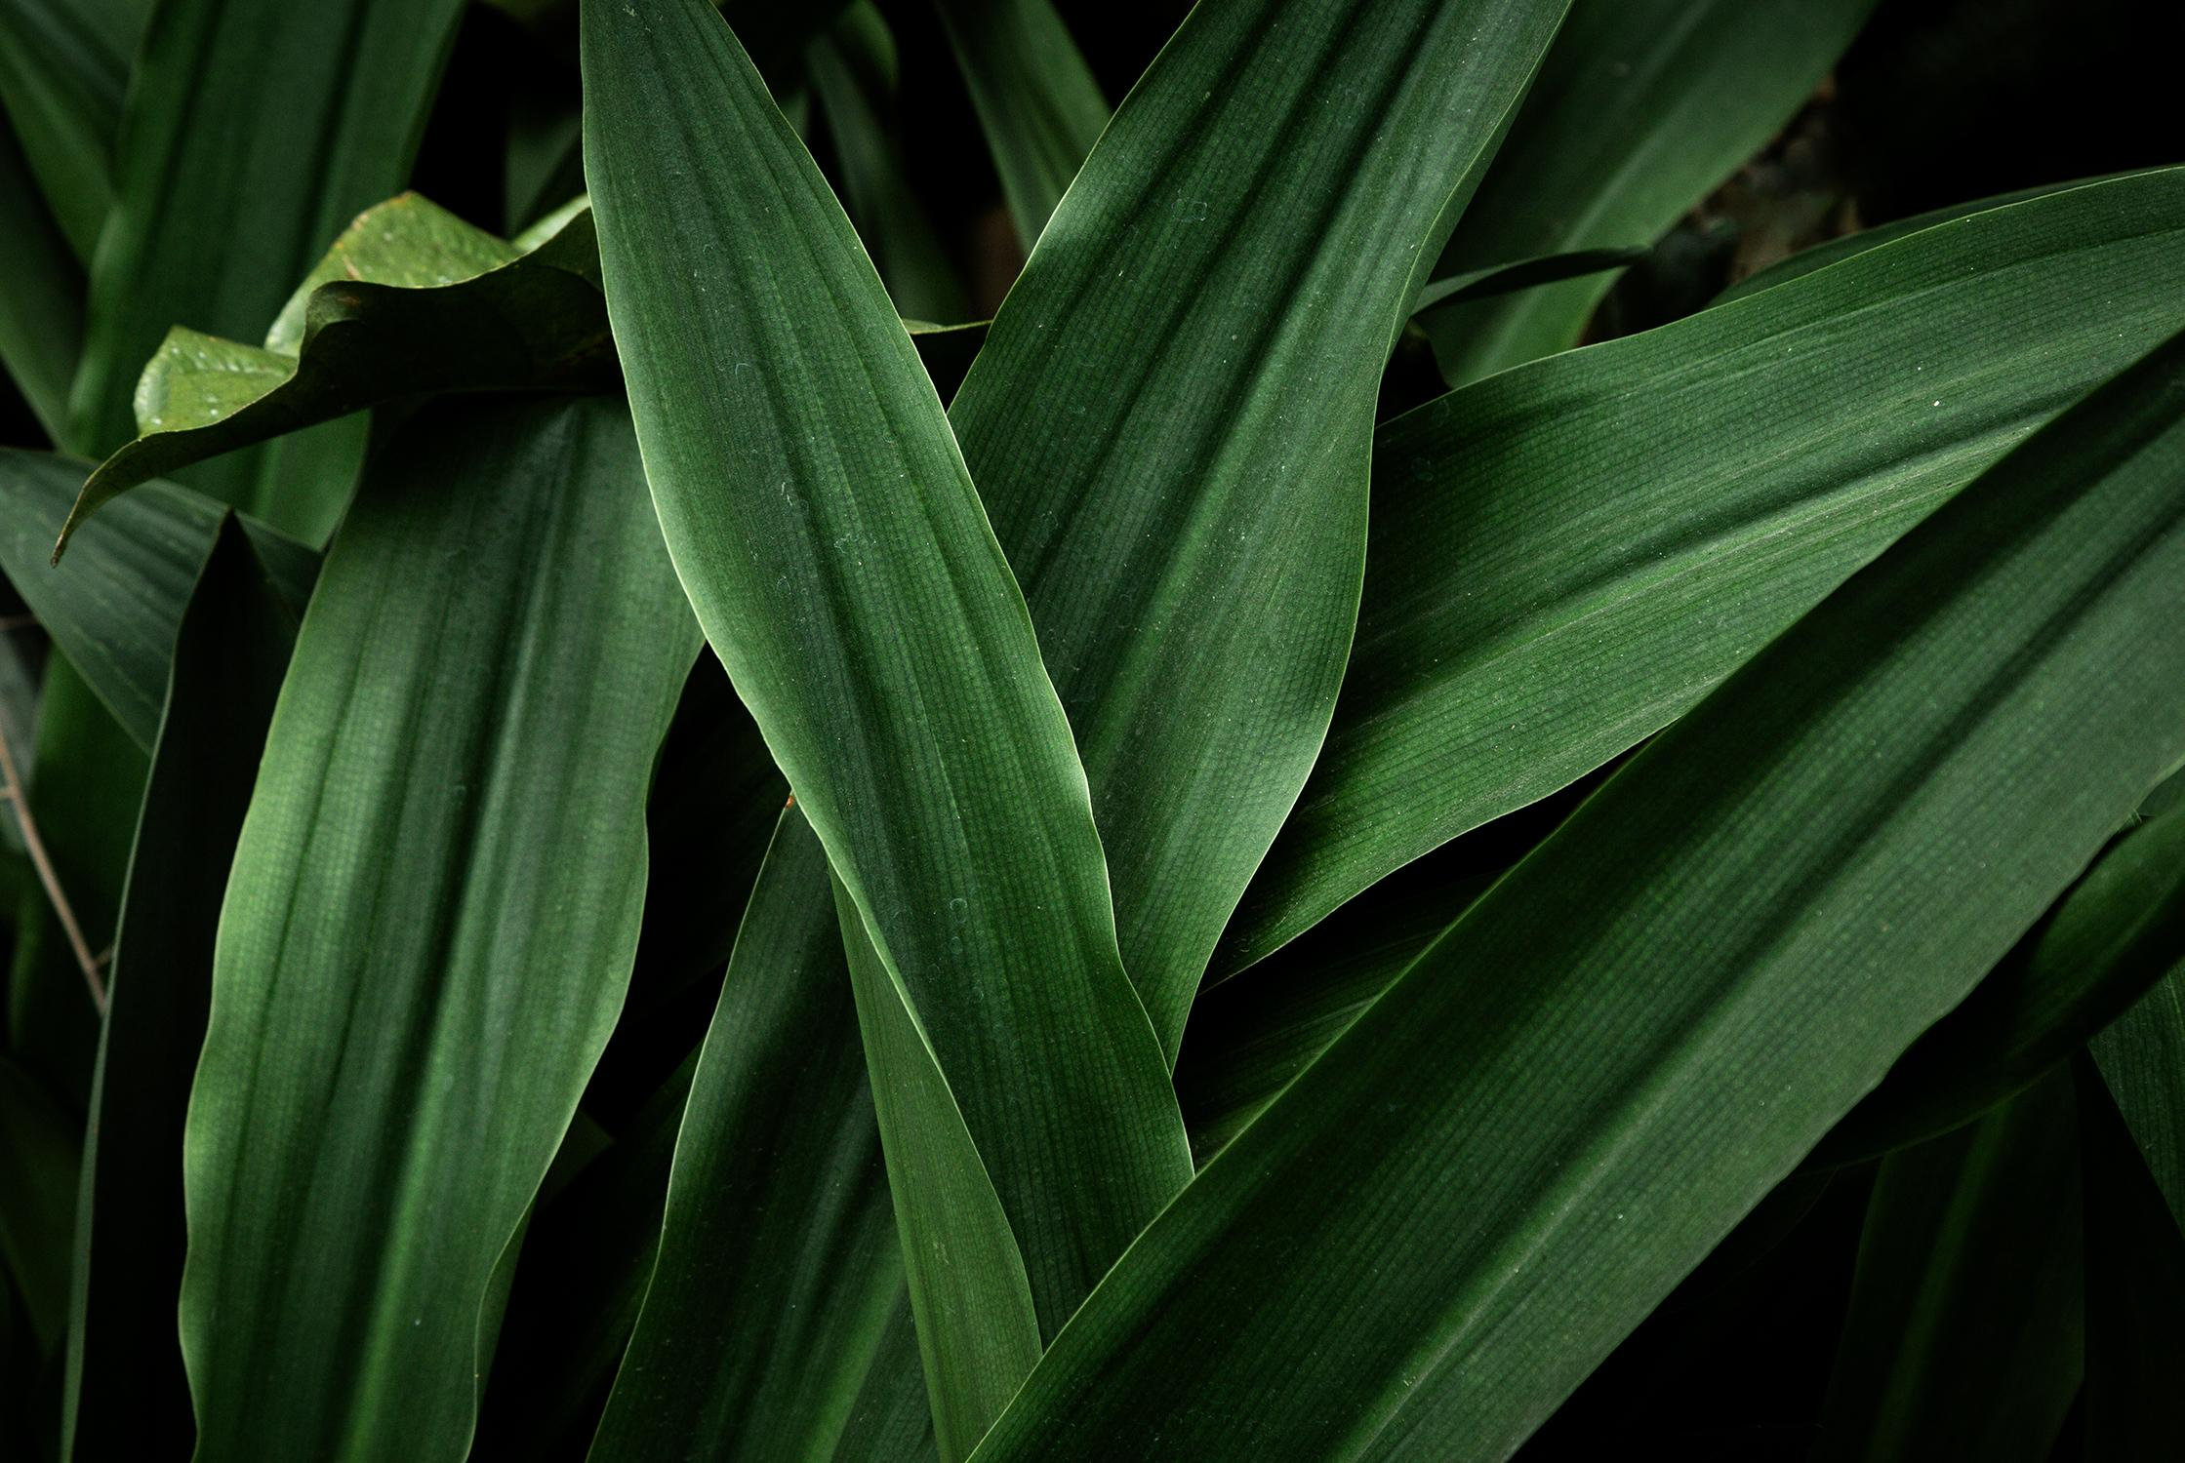


OUR TEAM
Priyam Aneja
Chahak Garg
Monish
Vivek
20BAI10330
20BAI10280
20BAI10053
20BAI10303

Slide 3
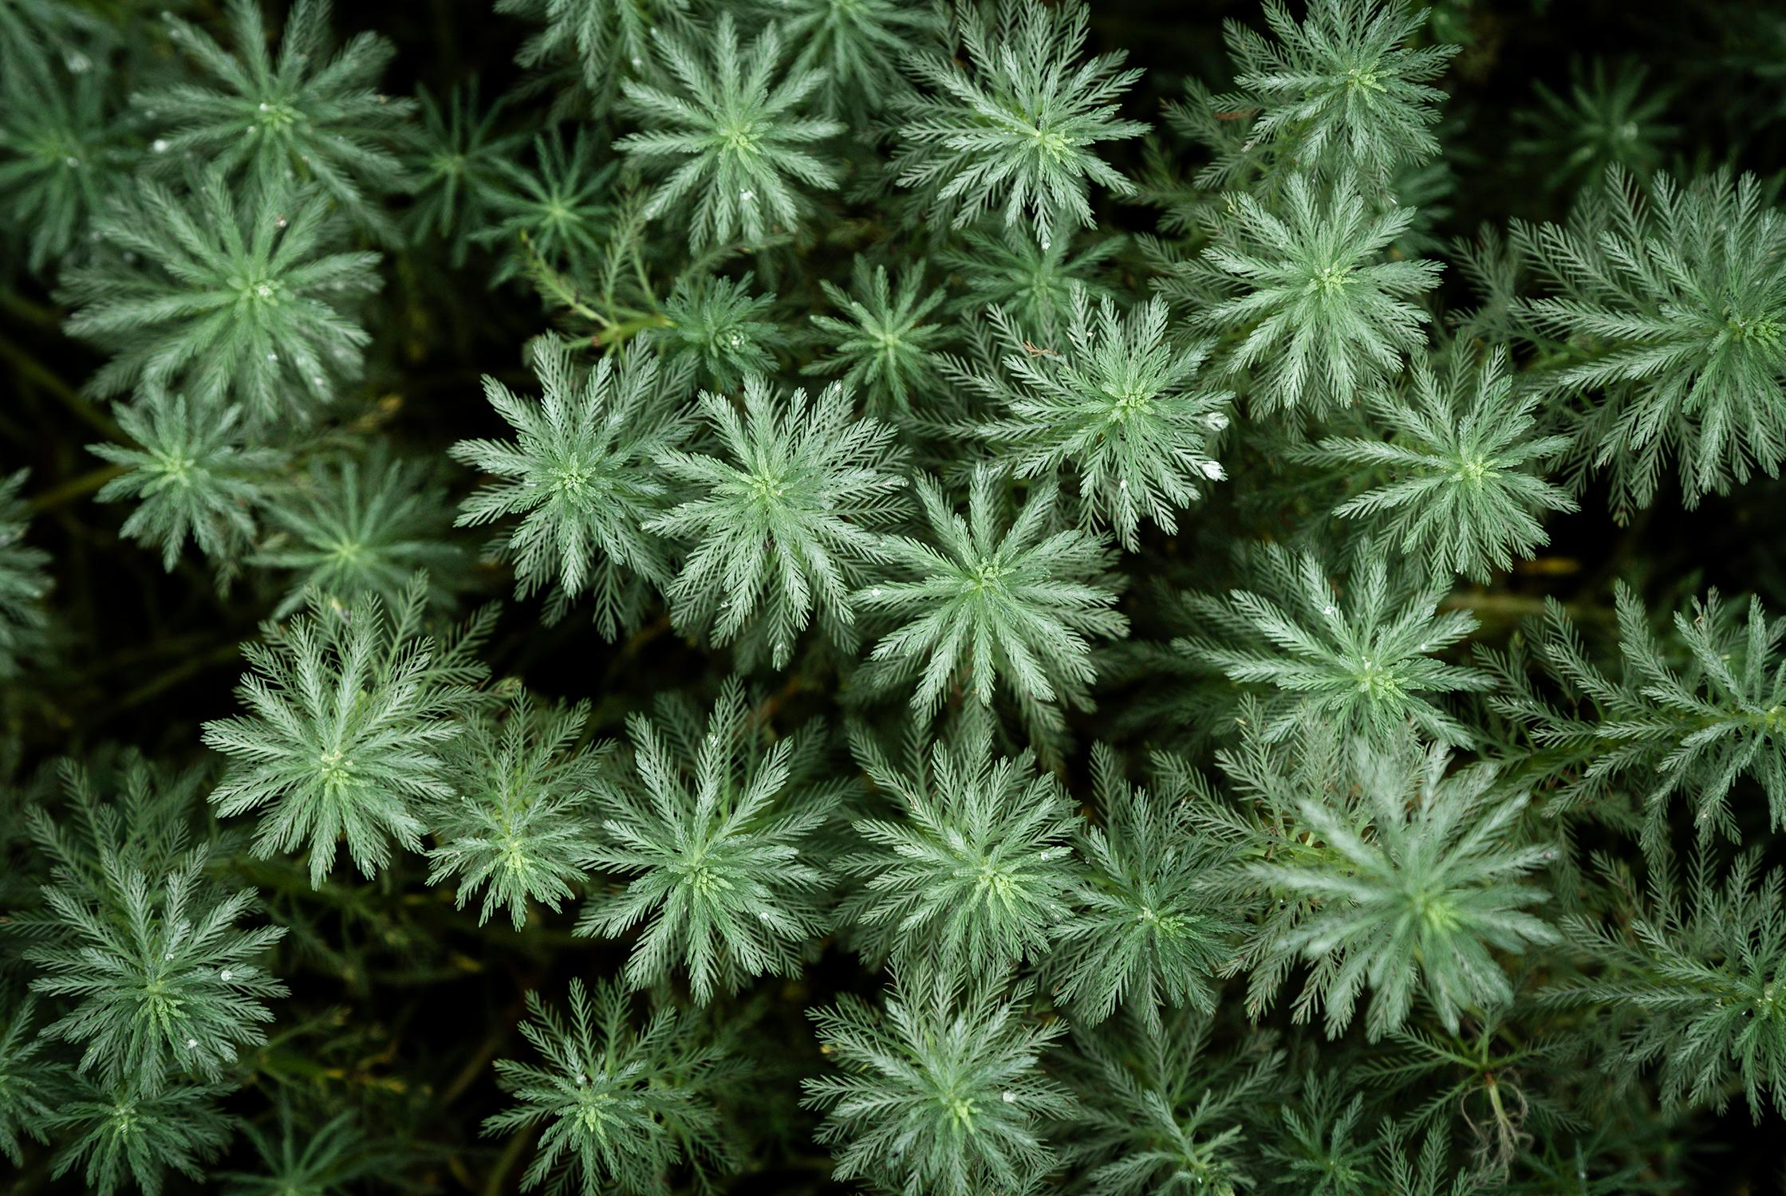
OUTLINE
Introduction
Existing Work
Proposed Work and Methodology
Novelty
Real Time Usage
Approach
Requirement Analysis
Hardware Requirements
Software Requirements
System Architecture Diagram

Slide 4
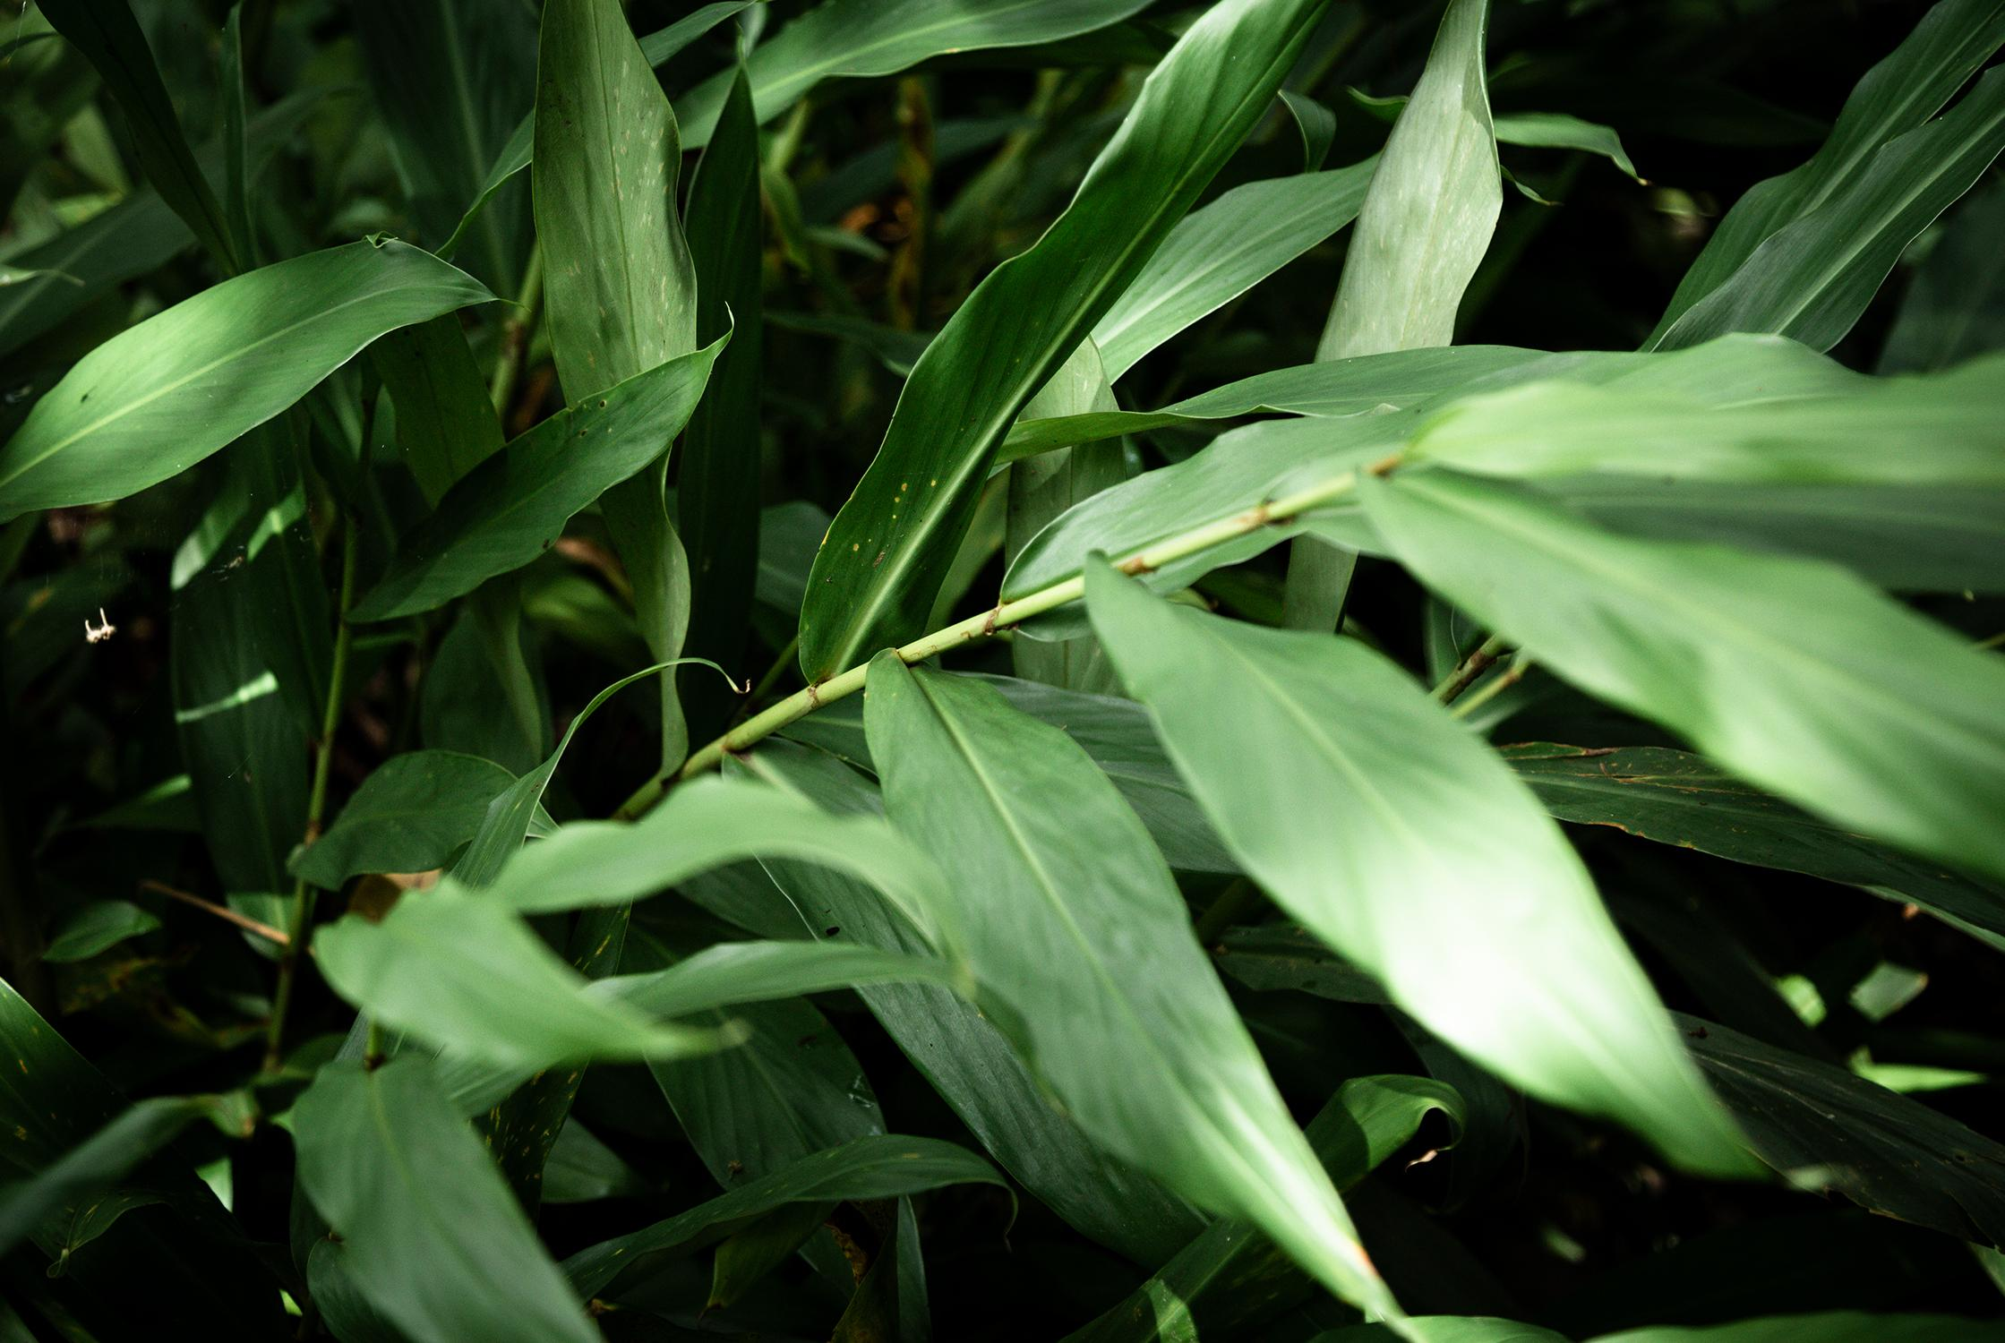
INTRODUCTION
We are approximately losing 80,000 acres of tropical rainforest daily and trying to cover up the loss, people are planting trees outside their houses, free land around them and in their garden. Our goal is to help them grow healthy disease-free plants, and we will be doing so by training a model using machine learning.
Our model:
Will identify the disease/problem
Totally free of cost

Slide 5
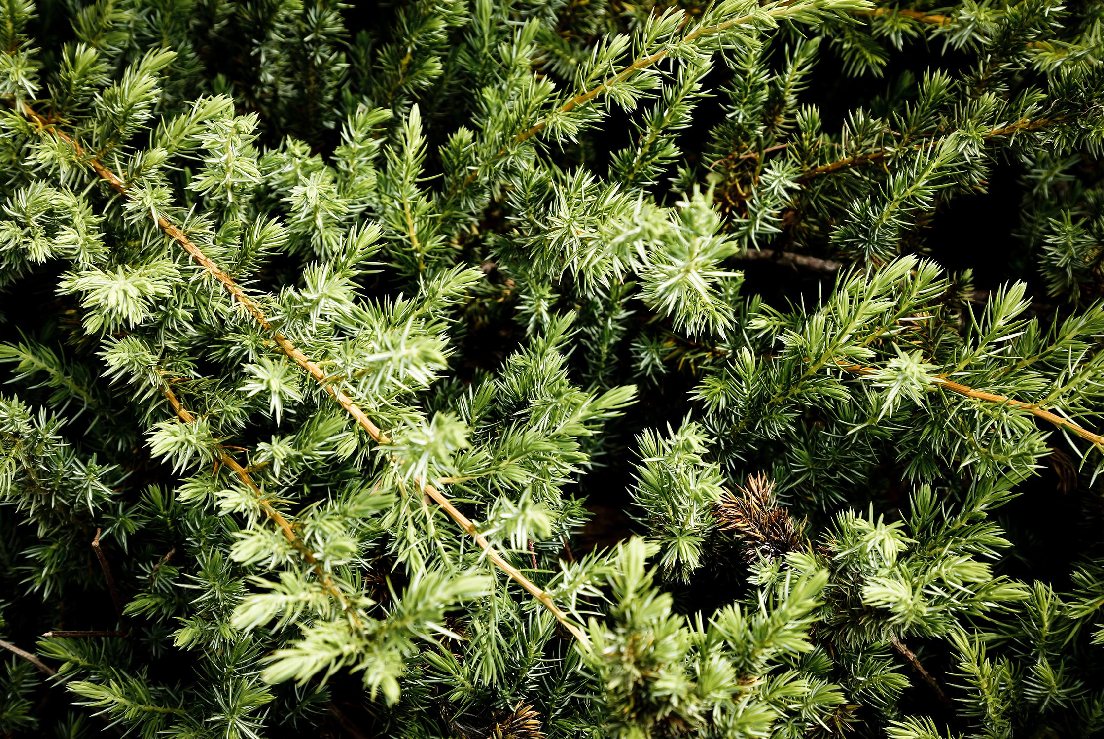
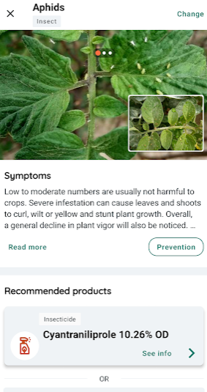
Existing Work
There are existing ways in which we can detect plant diseases but these do not focus on general plants.
Though these applications are useful for the farmers but ours will also be useful for occasional users.
These are not easily available and paid but ours will be free to use.
Those applications are quite complicated to understand.

Slide 6
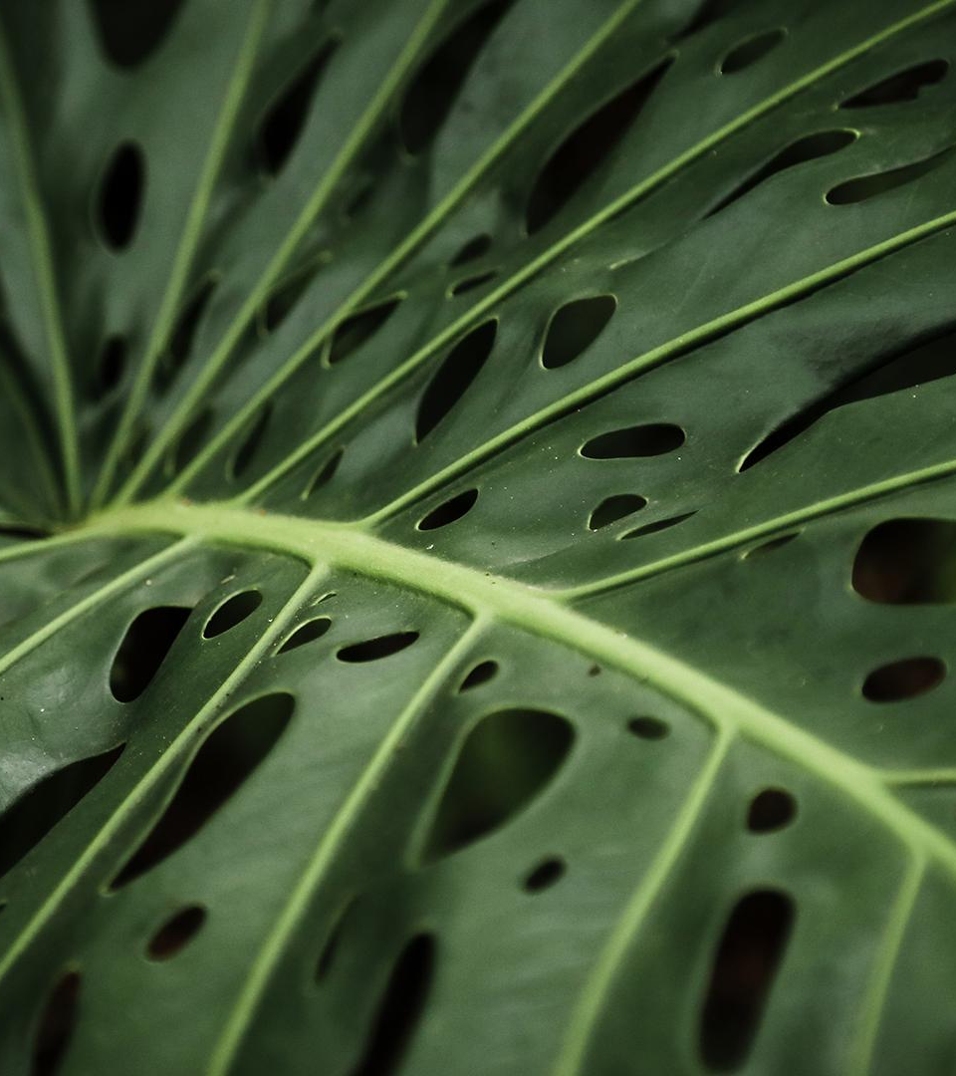
Proposed Work and Methodology
Our main focus is to help anyone having plants, it could be home, garden, decorative or nutrition. Anyone having an issue with any plant problem.
If the plant requires more water or sunlight or the soil need to be replaced. Such small factors also matter and common people find it difficult to understand them. Through our project we want to solve this problem.
For farmers we want to make our interface as simple as possible, so that they don’t find it difficult to understand.

Slide 7
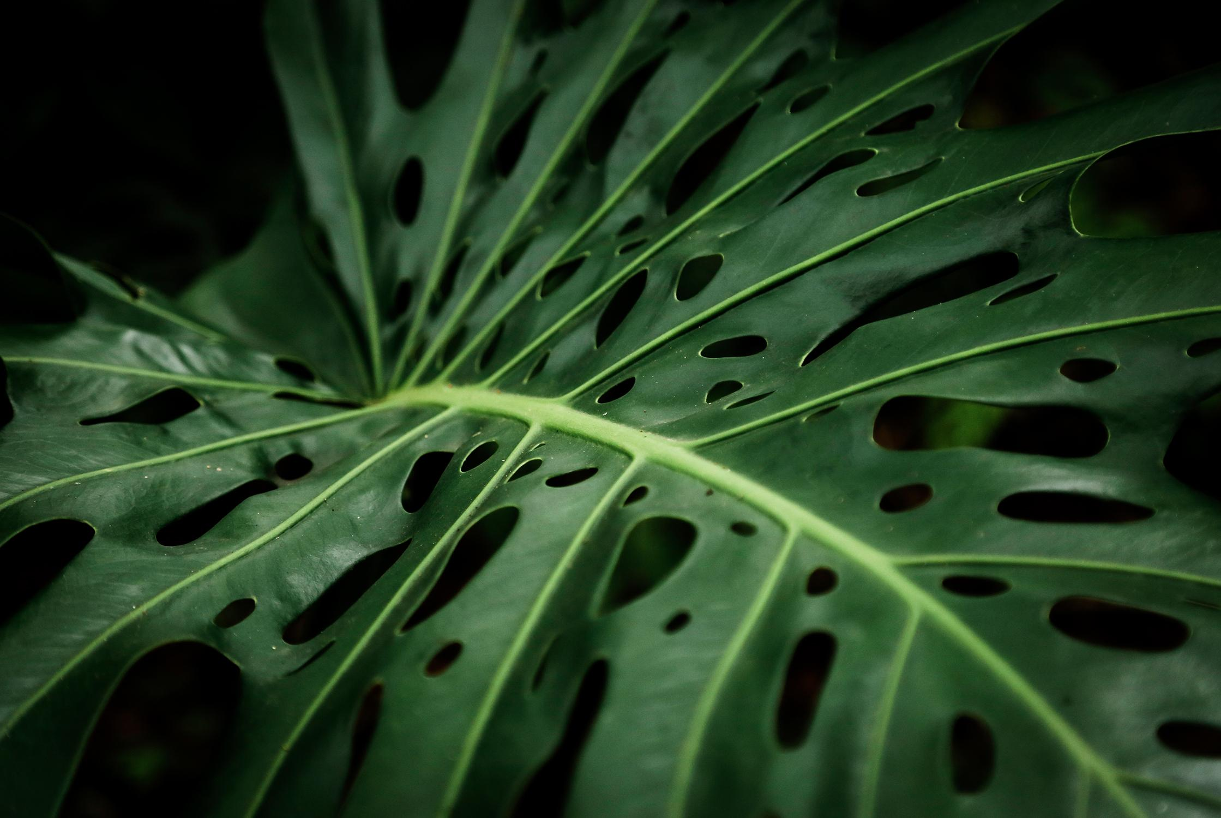
Novelty
Our project is different from the rest because most of the apps are paid and show complicated analysis. Common people cannot use them and even if they detect the disease/problem, they do not provide the solution.
We want to me make plantation easy and efficient.

Slide 8
Real Time Usage
The real time usage of software can be broken into following step which cover everything from data collection to disease detection.
Collect the images of different types of leaves and then create a dataset
Processing Image
Extract the features of leaf
Applying Machine Learning Algorithm
Train Neural Network
Test NN
Display and Compare results
Disease is detected and displayed

Slide 9
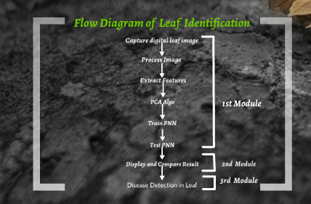
Approach

Slide 10
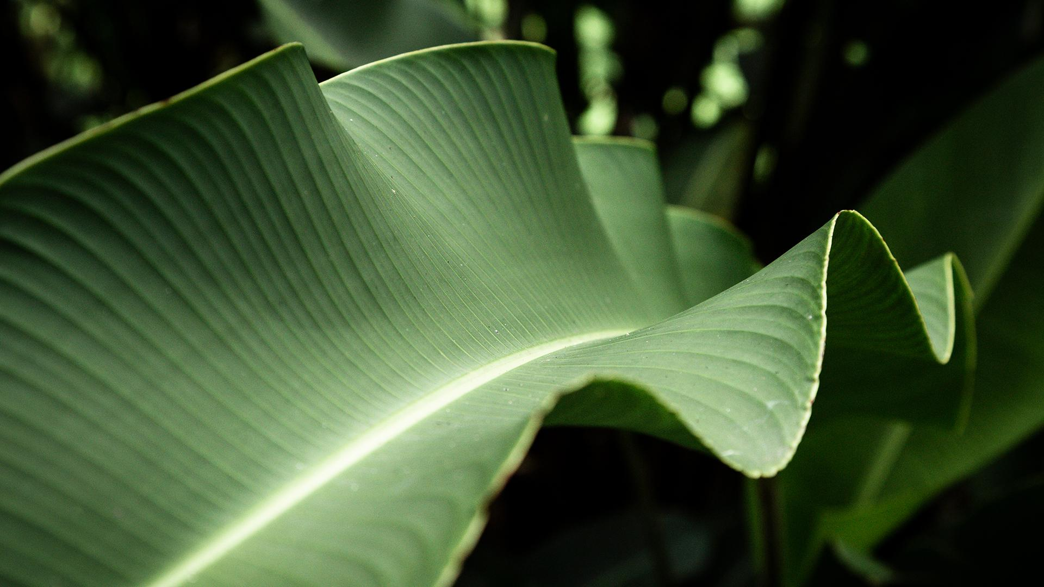
Requirement Analysis

Slide 11
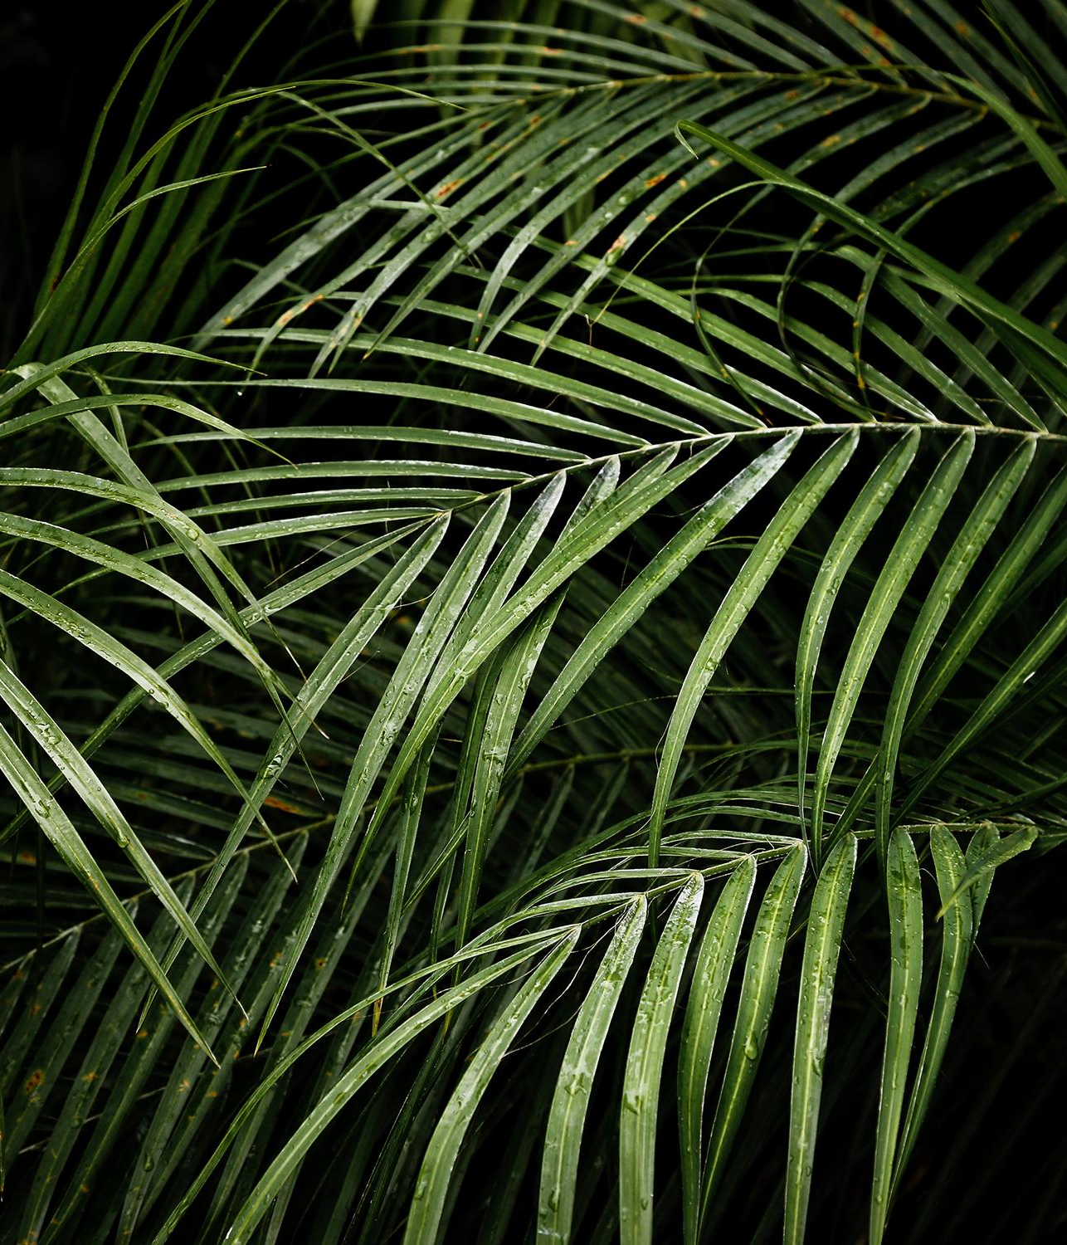
Software
Hardware
As our idea would require multiple machine-learning models, we would benefit with a powerful GPU in our system. A camera that provides decent picture quality would benefit us in project to determine the leaf and its disease. Due to number of images, RAM(16-32 GB) is required. Processor i5 or higher is recommended for better performance.
We would be using multiple machine learning models, probably be written in –
Choice of deep learning architecture: AlexNet or GoogleNet or PNN or CNN
Python libraries –
TensorFlow == 2.3.1
NumPy == 1.18.5
Pandas
Matplotlib == 3.3.2
Scikit Learn == 0.0
PyTorch == 1.8.0

Slide 12
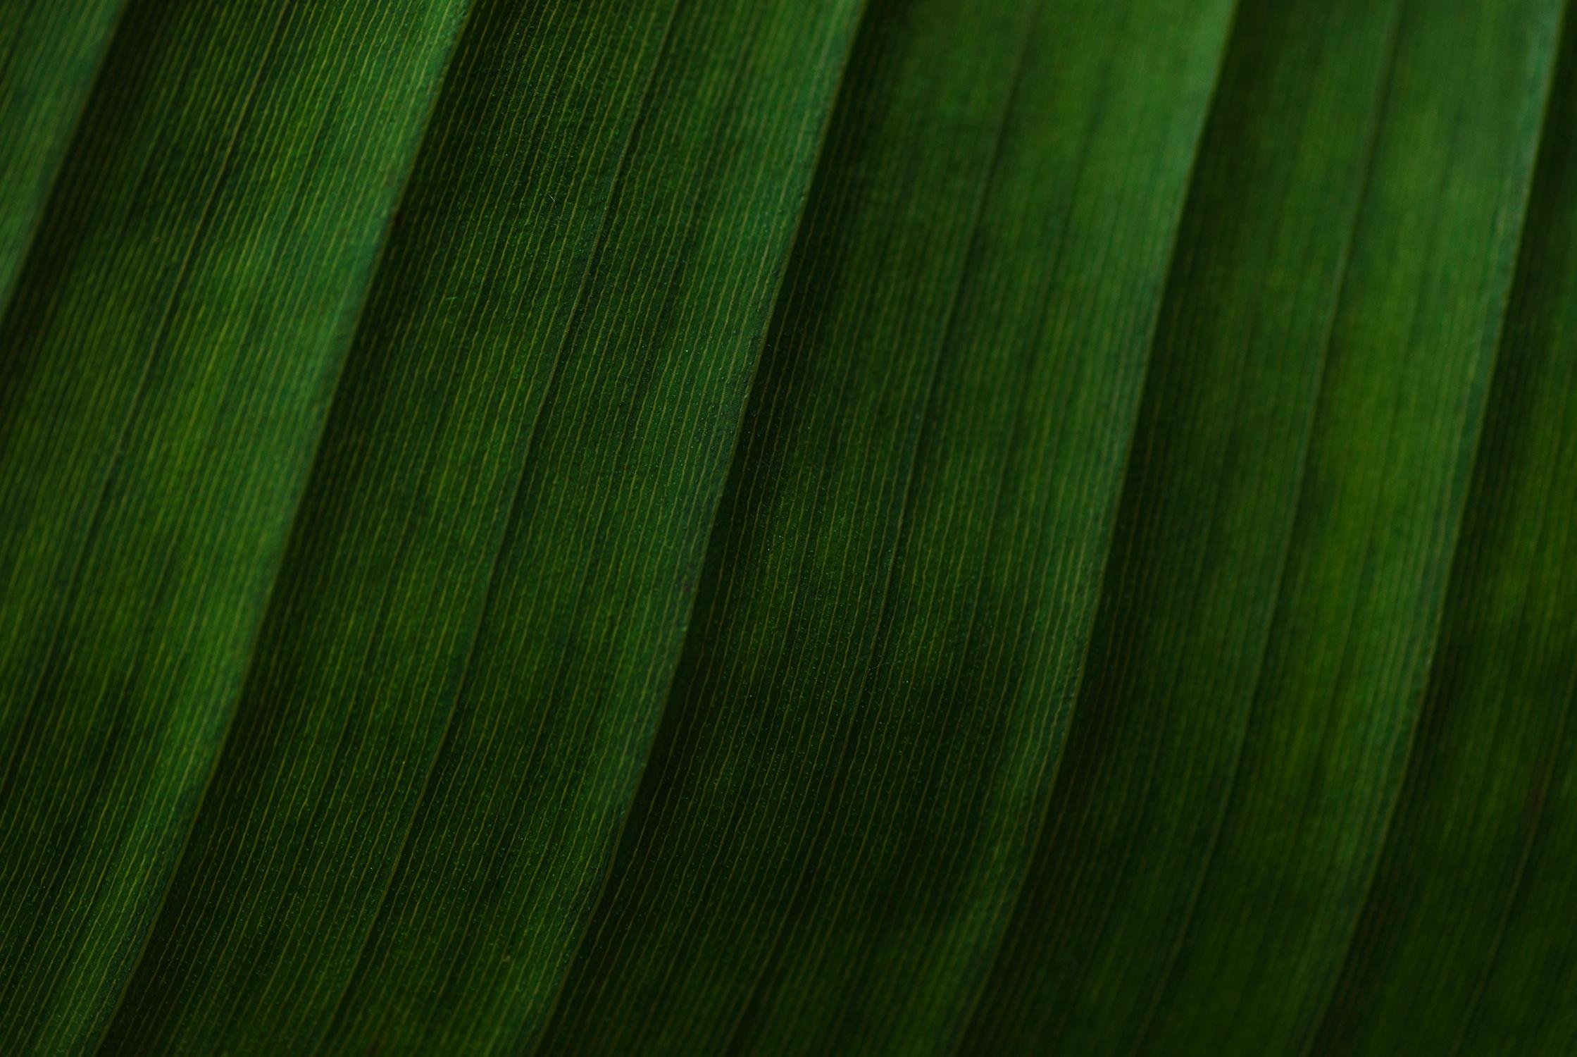
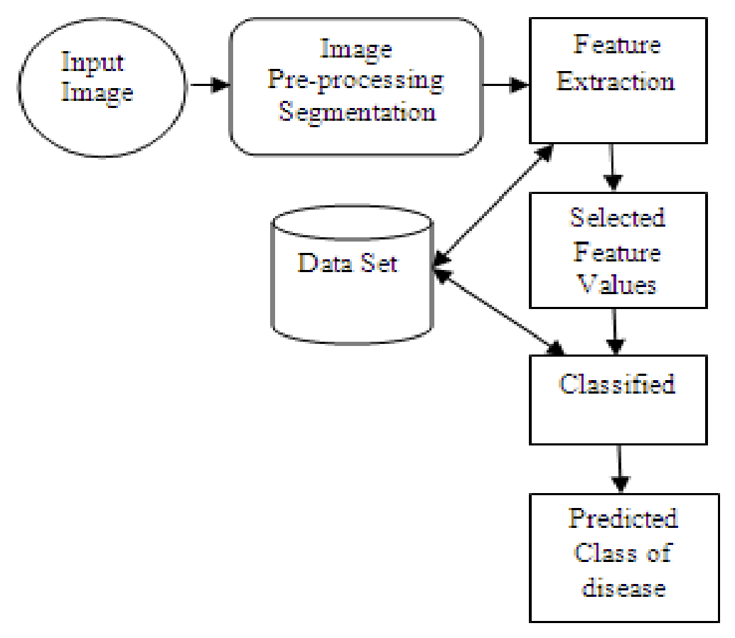
System Architecture Diagram

Slide 13
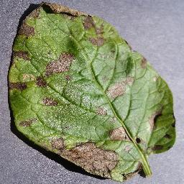
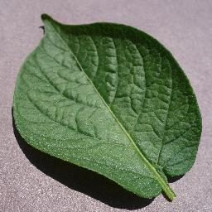
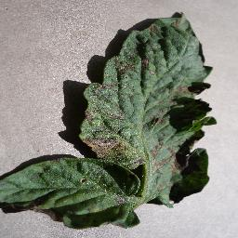
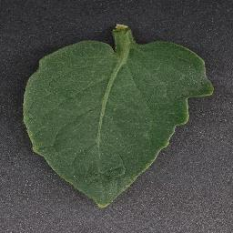
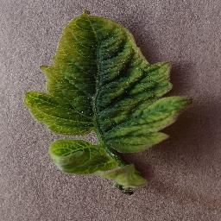
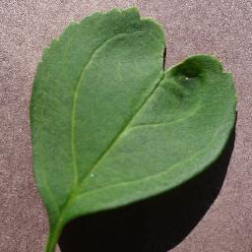
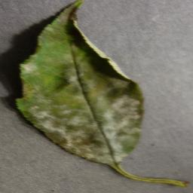
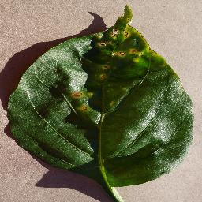
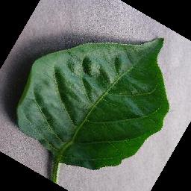
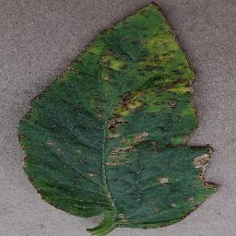
DATASET
Potato early Blight Potato healthy Tomato Early Blight Tomato Healthy Tomato Yellow Cur Virus
Cherry Healthy Cherry Powdery mildew Pepper Bacterial spot Pepper Healthy Tomato Bacterial Spot

Slide 14
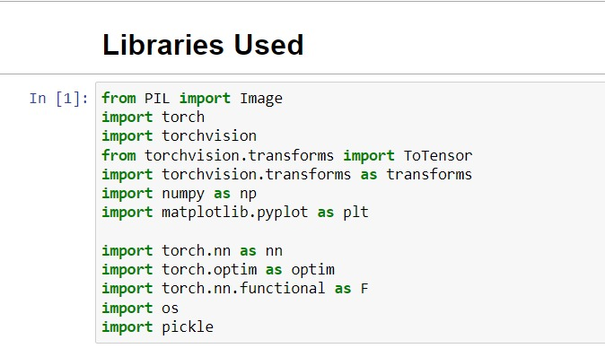
MODULE SPLIT-UP

Slide 15
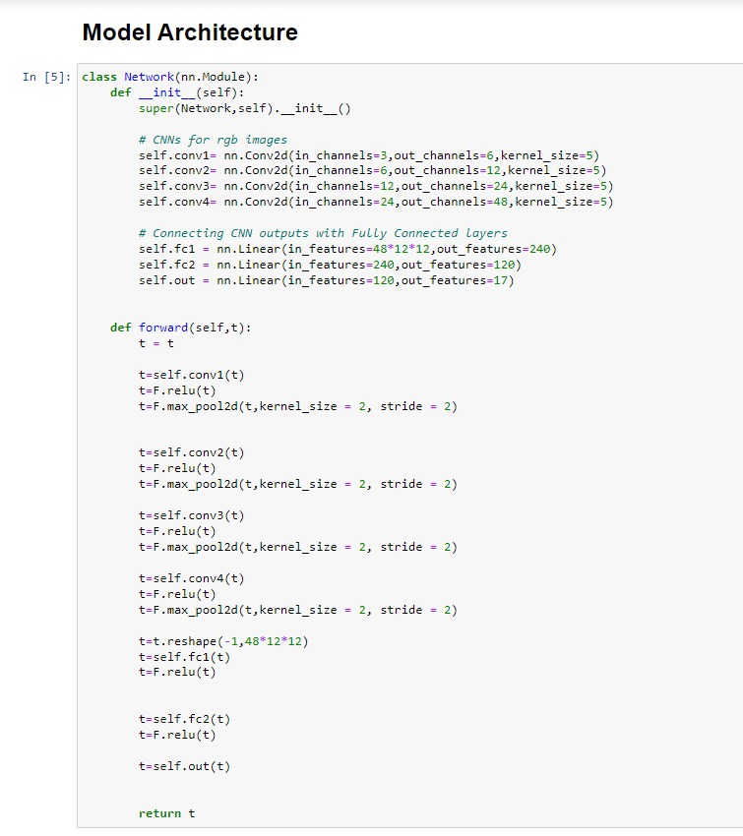

Slide 16
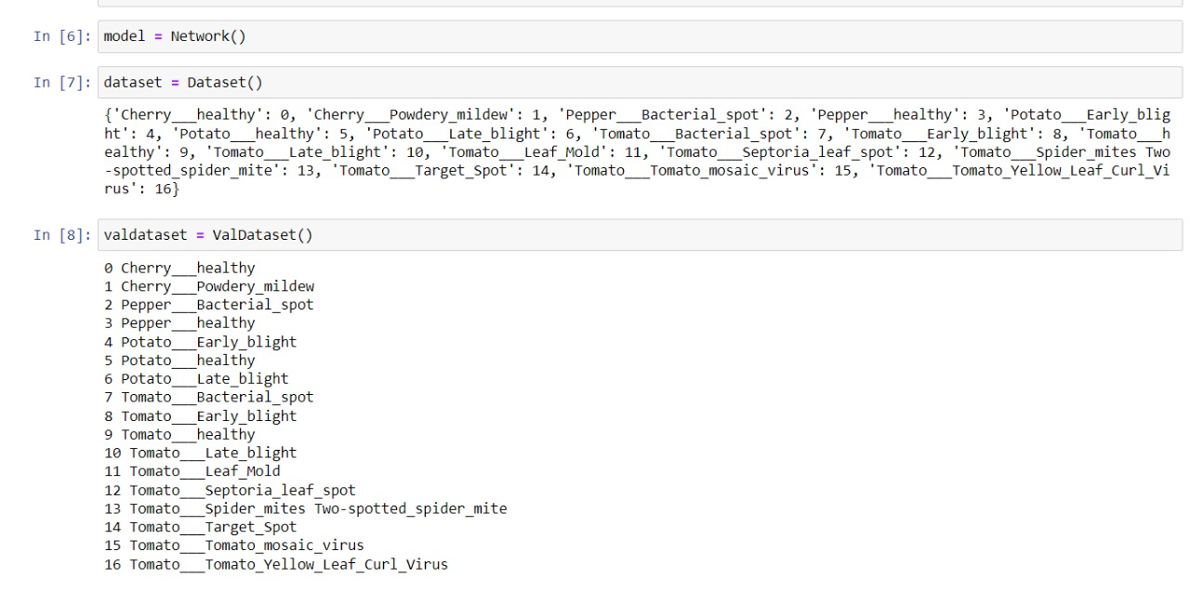

Slide 17
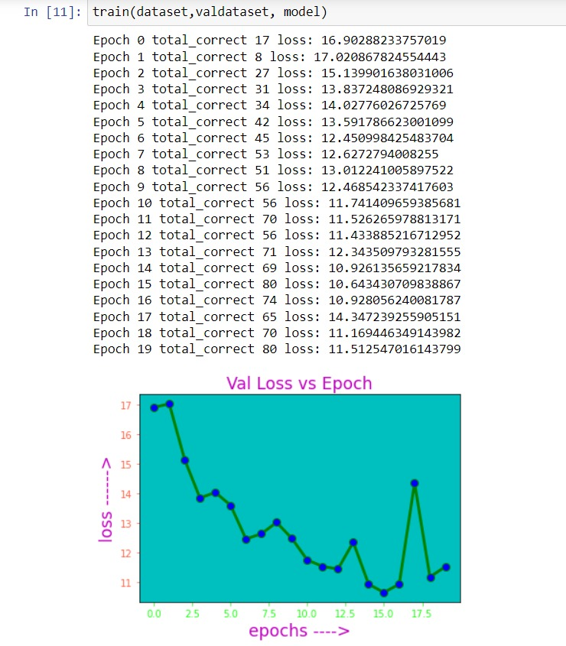

Slide 18
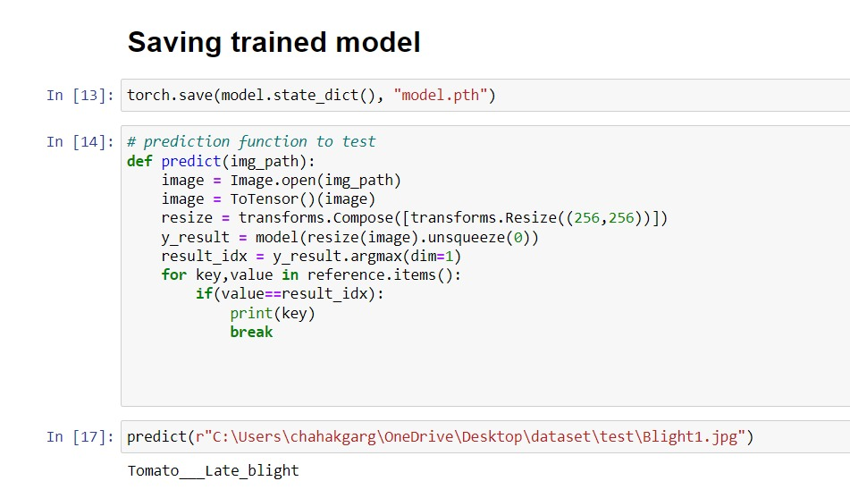

Slide 19
Thanks
If you have any doubts, feel free to ask!

